Slide 1
Guideword + Parameter = Deviation

Slide 2
HAZOP Guidewords

Slide 3
Additional Guidewords

Slide 4
Combination Examples

Slide 5
Process Parameter Examples

Slide 6
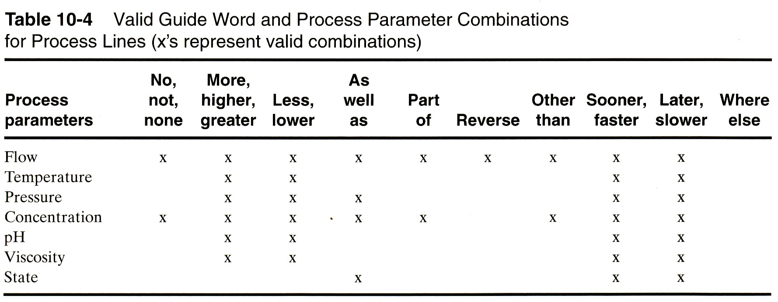
Parameter Guide Word Combinations, Process Lines
Crowl, D.A. and Louvar, J.F., Chemical Process Safety, 2nd ed, Prentice Hall, 2002

Slide 7
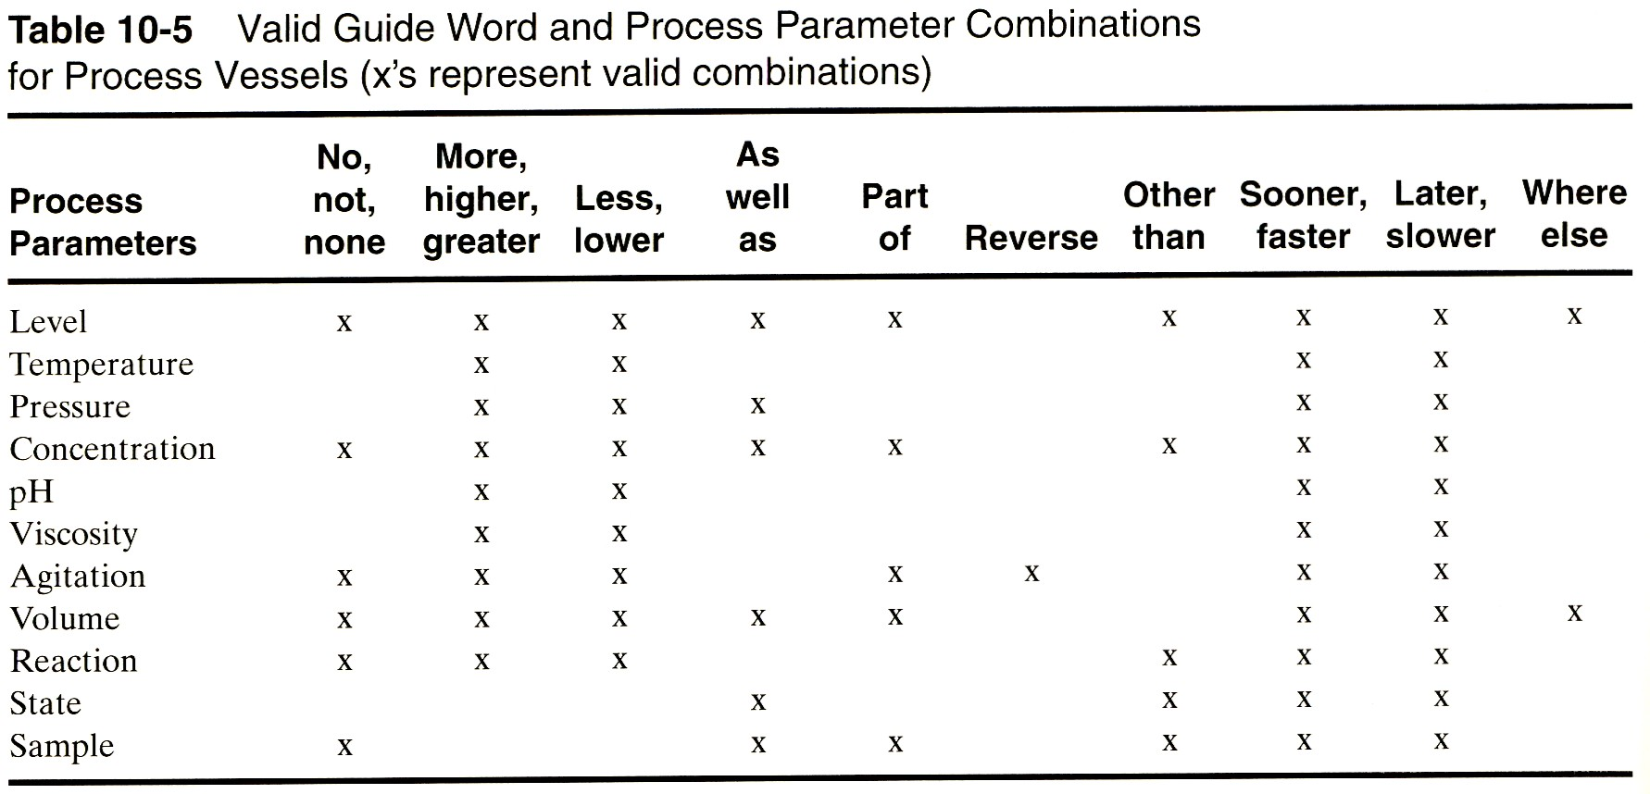
Parameter Guide Word Combinations, Vessels
Crowl, D.A. and Louvar, J.F., Chemical Process Safety, 2nd ed, Prentice Hall, 2002

